Slide 1
Learning Collaborative to Address Diabetes Prevention :Social Determinants of Health July 30, 2020

Slide 2
Housekeeping
All attendees are placed on mute.
This webinar will be recorded and shared via email.
If you have any questions, please type them in the Q/A box and we will address them during the Q/A session.
ACPM will email the participants a brief feedback survey after the webinar.

Slide 3
Please answer the poll questions.

Slide 4
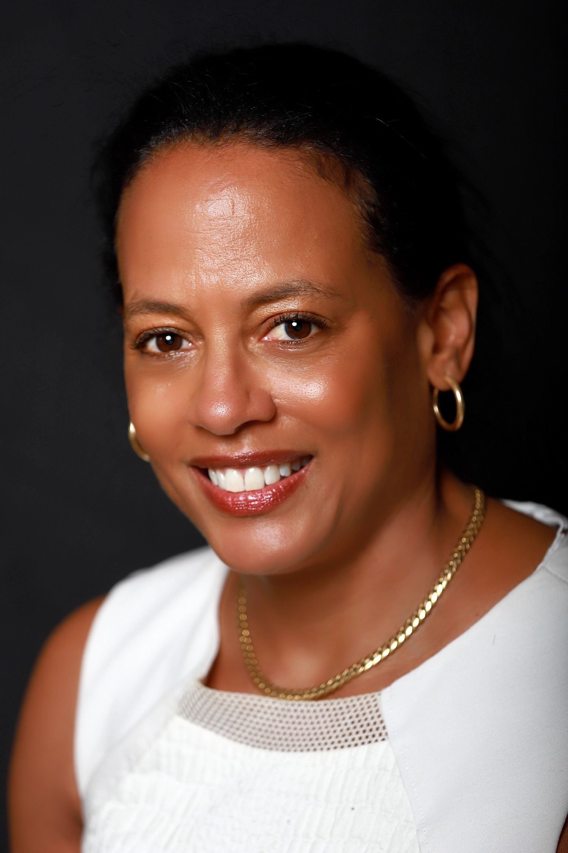
Linda Goler Blount, MPH President and CEO
Notes:
Linda Goler Blount joined the Black Women’s Health Imperative in 2014. As President
and CEO of the only national organization focused on Black women’s emotional,
physical and financial health and wellness, Linda has overseen more than $20 million
invested in Black women to prevent chronic diseases and HIV, ensure reproductive
justice and healthy maternal outcomes and advocate for policies that protect Black
women. Before joining BWHI, Linda was the first-ever national vice president of health
disparities at the American Cancer Society where she was responsible for developing a
nationwide health equity strategy to reduce cancer incidence and mortality among
underserved populations. She has extensive international health experience and has
served as a consulting epidemiologist to government ministries in Germany, South
Africa, Zimbabwe, Malawi, Jamaica, and Trinidad and Tobago, where she lived for four
years. A speaker, published author and advocate, Linda is a champion for the rights of
Black women.

Slide 5
Keshee Dozier-Smith CEO
Notes:
Mrs. Keshee Smith
Chief Executive Officer - Rural Health Medical Program, Inc.
Mrs. Dozier-Smith is the Chief Executive Officer of the Rural Health Medical Program, Inc., which is a Federally Qualified Health Center offering primary healthcare, dental, optometry, and podiatry, behavioral and mental health services to the Dallas, Marengo, Monroe, Perry, and Wilcox Counties. It has been through her leadership and her passion to give back to her hometown community that the Black Belt community has begun to see tremendous improvements in their access to and quality of health care services. What started as one (1) Community Health Center within a Public Housing Authority providing Primary Health Care and Dental services to the entire community of Uniontown, Alabama, has since grown from one (1) site with ten (10) employees over the past forty (40) years to eight (8) Community Health Center sites and one (1) mobile clinic unit with over sixty (60) employees under the leadership of an exceptional Board of Leaders representing five counties (Dallas, Perry, Marengo, Monroe, and Wilcox) counties and a multi-talented, charismatic, intelligent Chief Executive Office, Keshee Dozier-Smith.
Serving as the Chief Executive Officer of the Rural Health Medical Program Incorporated, Mrs. Dozier-Smith has tremendously transformed and set this organization on the right path to effectively and efficiently operate beyond another 40 years. RHMPI has been a pillar of primary and preventative health care system across five (5) Black Belt Counties in the state of Alabama offering quality, cost effective, and easily accessible primary medical and specialty services to each community member regardless of their ability to pay with and without insurance.
It is our goal to continuously improve the number of patients served each year through increasing patient access to our primary healthcare services, awareness of services we offer, and by partnering with other community agencies to connect individuals across the communities we serve to tangible resources needed in their everyday lives.
Mrs. Dozier-Smith has dedicated her time, energy, and support in developing a new management and support team by 69 staff members which has contributed to improving the operational and system of care delivery, patient satisfaction and experience, and local economies Centers (Dallas, Marengo, Monroe, Perry, and Wilcox) by offering employment opportunities and reducing the unemployment rates. She continued to grow the organization over the past five (5) years from five (5) health centers thirty six (36) employees and seven (7) services across four (4) counties to nine (9) sites, sixty nine (69) employees and over eight-teen (18) services across five (5) counties.
Mrs. Dozier-Smith attended Spelman College in Atlanta, Georgia graduating with a Bachelors of Arts Degree in Economics with a minor in Business Management in 2008. She has obtained serval professional certifications throughout her work experience in both cooperate American and within the Non-profit workforces such as: Talent Management, Project Management, Organizational Change Management, Grant Writing and Management.
Mrs. Dozer-Smith has worked with various Fortune 500 ranked companies such as Limited Brands, United Healthcare, and Accenture. She has over six years of experience as a Change Management & Talent Organizational Manager and Human Resource & Employee Engagement Specialist. She is also the Founder of the Black Belt Community Development Coalition which is an organization that assists individuals and families transition from homelessness to model community members that have a home, continued their educational pursuits, received on the job training, and maintains financial stability with guidance from their assigned life coach.
Since servings as the Chief Executive Officer, Mrs. Dozier-Smith has serves on various community and professional boards which support efforts in the promotion of socio-economic development, community outreach and health and wellness across the Black Belt region. Mrs. Smith is an active member of Alpha Kappa Alpha Incorporated, The Links Incorporated, Leadership Selma, and Board Member of the Alabama Primary Care Association, Congressional District 07 COVID-19 Advisory Board. Mrs. Smith is a loving wife, mother of four children and a devoted Community Leader of the Black Belt counties of Alabama.

Slide 6
The Long and Bumpy Road Toward Health Equity

Slide 7
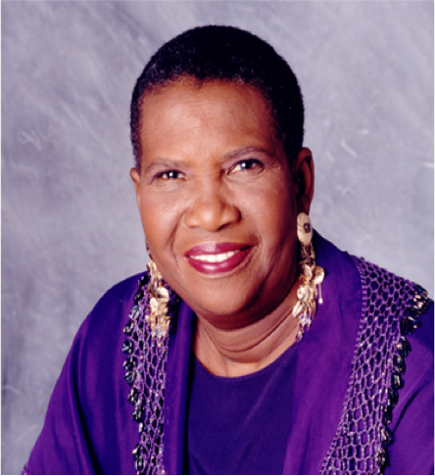
Spelman College 1983
Notes:
The Black Women’s Health Imperative was established by Byllye Avery on the campus of Spelman College in 1983 at the Black Women’s Health Project. Ms. Avery is still an active contributor to BWHI as a Board Member.

Slide 8
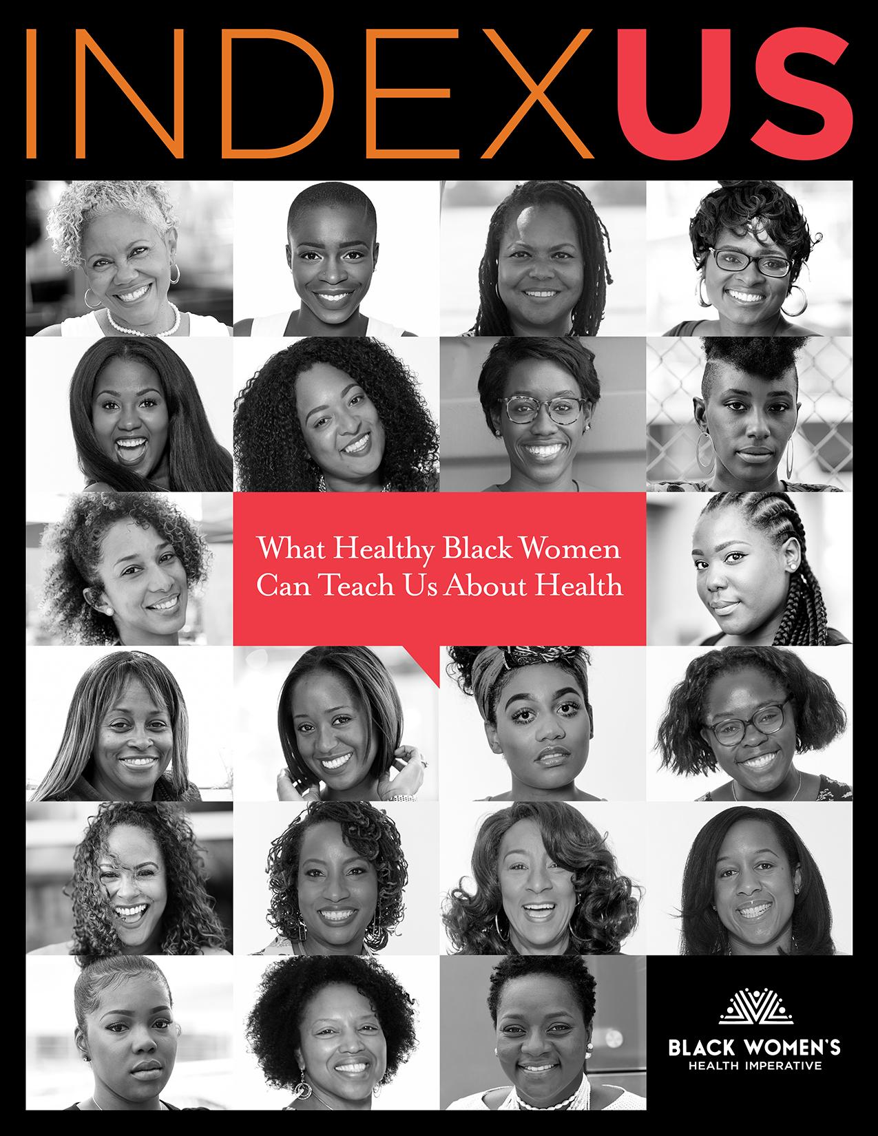
What We Do
BWHI is a national non-profit organization dedicated to advancing health equity and social justice for Black women through policy, advocacy, education, research and leadership development.
WE LEVERAGE ASSETS
WE CREATE THE MESSAGES
We implement wellness programs in select cities and promote medical literacy across digital platforms, events and partnerships.
We published the first-ever comparative analysis of Black women’s health based on healthy Black women.
WE ADVOCATE
WE REDUCE BARRIERS
In 2018, we released our legislative agenda to build upon Black women’s legislative influence, ballot power and commitment to civic engagement.
We implement initiatives to educate and increase insurance enrollment, clinical research participation, and access to preventive services.
Notes:
Fund chronic diseases prevention programs in 12 states
Support enrolling women in health insurance and helping them understand how to use it.
And participation in Clinical Research through working with pharmaceutical companies on the importance of including Black women
Leg agenda
GOTV and accountability
Healthy – emotionally, physically and financially.

Slide 9
High-Touch Coaching
for Positive Change
with Women of Color
LIVED EXPERIENCE
STRESS
INTERSECTIONALITY
Notes:
High Touch Coaching for Positive Change with Women of Color
the partners in the BWHI’s network of National DPP providers, deliver our Change Your Lifestyle. Change Your Life. CYL2 which is the Imperative’s brand of the CDC’s National Diabetes Prevention Program
With ACPM, BWHI focuses on SDOH Program delivery and retention
Transitioning from in-person to virtual classes during pandemic

Slide 10
CYL² PROGRAM HIGHLIGHTS
2012 One of CDC original six National DPP organizations
195 classes, 149 locations, 18 partners
2015 Designated CDC training entity 200 coaches trained
Notes:
2017 became a CDC legacy organization
Program delivered in English and Spanish
the partners in the BWHI’s network of National DPP providers

Slide 11
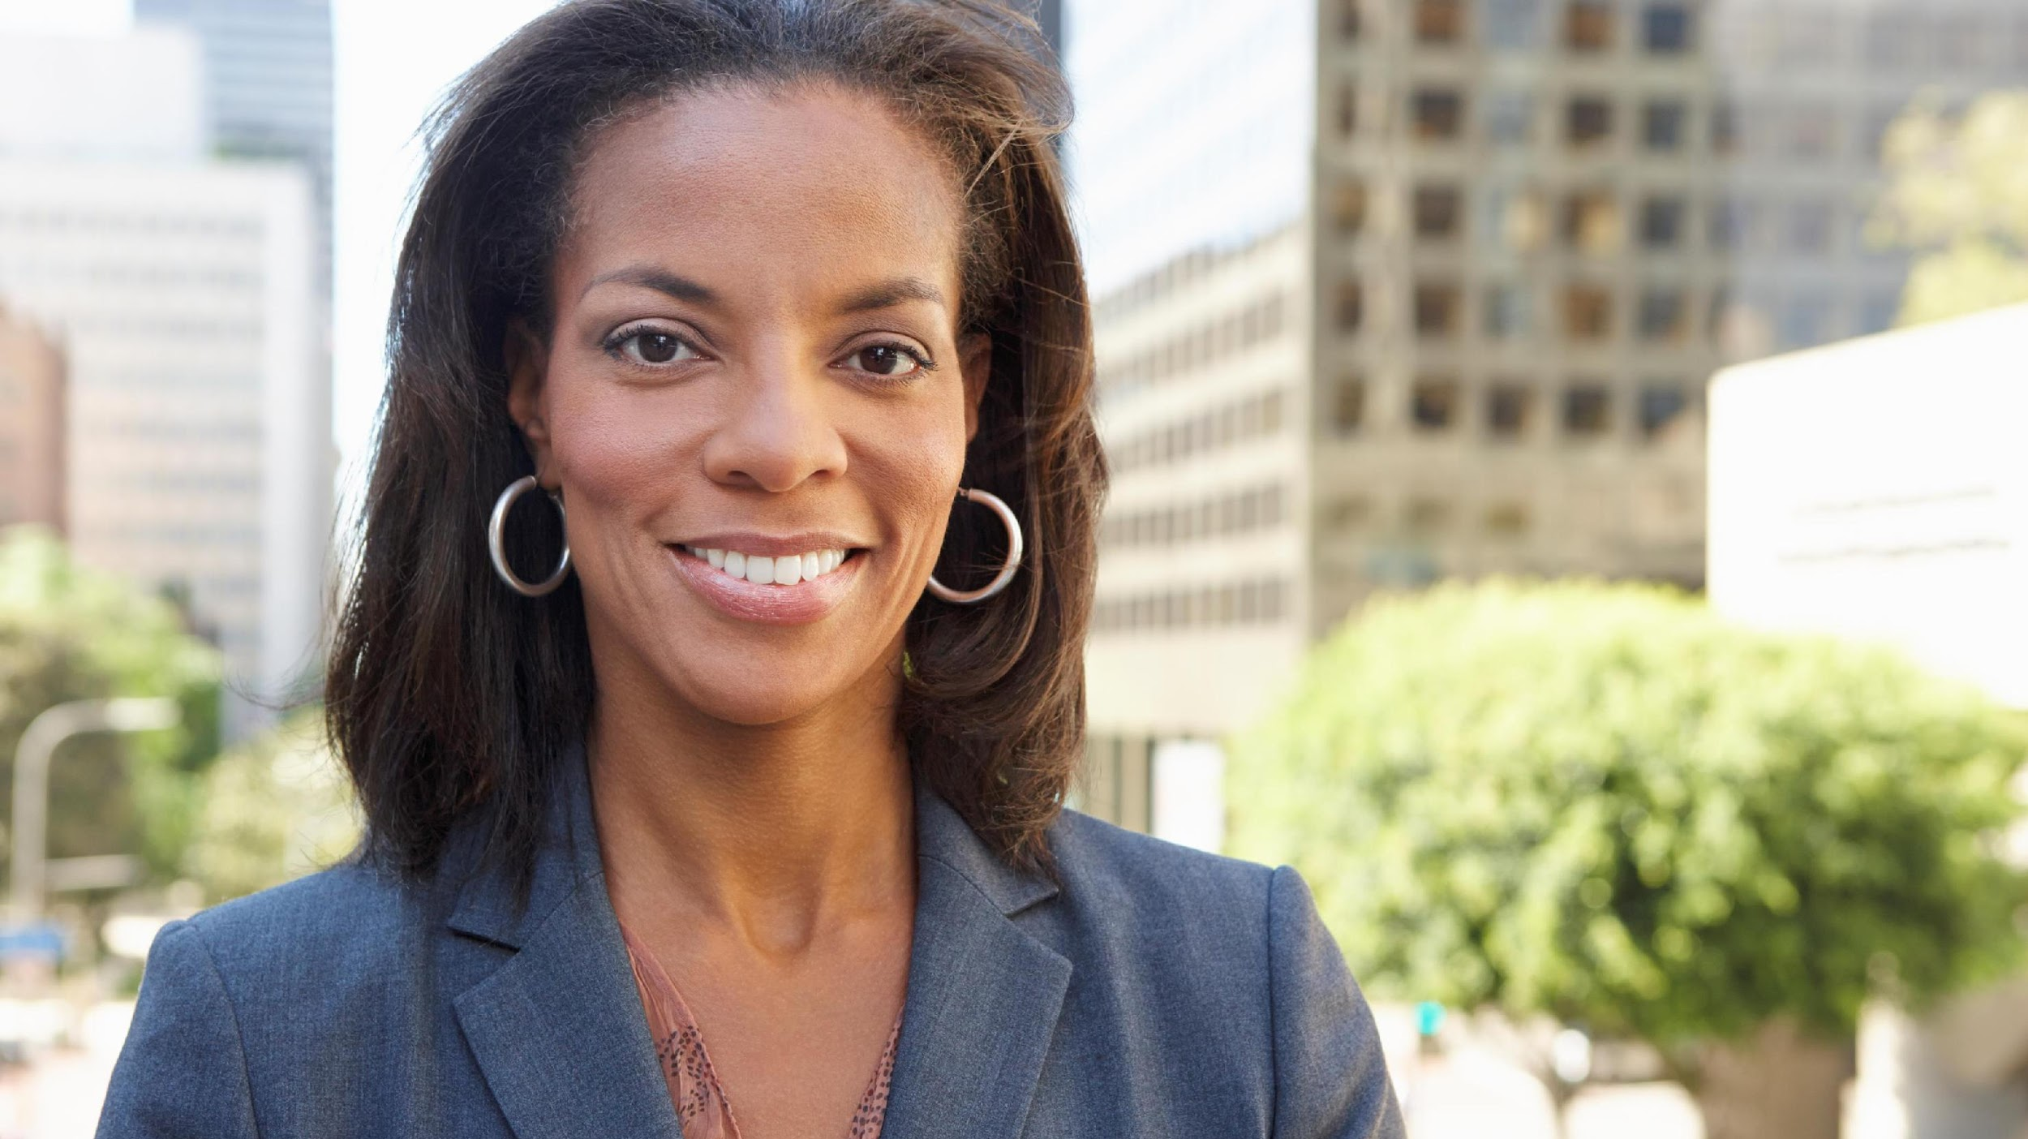
How Black Women Define Health
Notes:
Pause here to talk about how Black women define health
Mind-spirit-money

Slide 12
Black women are 2 times more likely to die due to type 2 diabetes than white women.
Notes:
African Americans with diabetes, as compared to their white counterparts with diabetes have:
➢ 1.8 times higher prevalence of diabetes ➢ 2.1 times higher rate of mortality due to diabetes ➢ 3.5 times higher rate of lower extremity amputation ➢ 4.2 times higher rate of ESRD from diabetes
racial/ethnic differences in hyperglycemia and receipt of screening services
NDPP was significantly less effective among black women, a group with a particularly high prevalence of obesity
Need to disentangle and understand sociocultural and contextual issues associated with the obesity problem in black women.

Slide 13
Notes:
Diabetes: https://www.cdc.gov/diabetes/pdfs/data/statistics/national-diabetes-statistics-report.pdf
Hypertension: https://www.cdc.gov/nchs/products/databriefs/db289.htm
Obesity: https://minorityhealth.hhs.gov/omh/browse.aspx?lvl=4&lvlid=25
Depression: https://www.cdc.gov/nchs/products/databriefs/db303.htm
Obesity Hispanic: https://minorityhealth.hhs.gov/omh/browse.aspx?lvl=4&lvlid=70

Slide 14
Stress
&
Black Women
Cortisol
Weathering
Metabolic Changes
Epigenetics
Notes:
Increasing research links mental and emotional health to physical health
Weight gain and loss
Self control!!!

Slide 15
Black women have 15% more cortisol in their blood stream at any point in time
Notes:
Cortisol - inflammation, stress, fight or flight
Allostatic Load – chronic elevated
Weathering
Accelerates aging
Over time
Telomeres are sequences of DNA at end of chromosome. Telomere length is viewed as an overall marker of biological aging
Sojourner Syndrome
Racist Police Videos - PTSD in black women – George Floyd
UFT
Fleda Mask Jackson – LBW babies / maternal mortality
BWH Study and Tene Lewis – found a causal relationship between experiences of racial discrimination and …
UFT
Obesity
LBW babies
Maternal mortality
Comparing Black and White women
Weight gain and loss
Self control!!!
impact of elevated stress - weight management, increased risk for diabetes, hypertension, etc.

Slide 16
Black Women
At Work
Black women work 20% more than White women
Notes:
No benefit
No cost savings
No increased revenue or productivity
Toll on our health
No one would notice if we stopped

Slide 17
The “Social Determinants” Narrative

Slide 18
Discrimination & Health: Tene Lewis
Everyday Discrimination: positively associated with:
-- coronary artery calcification (Lewis et al., Psy Med, 2006)
-- C-reactive protein (Lewis et al., Brain Beh Immunity, 2010)
-- blood pressure (Lewis et al., J Gerontology: Bio Sci & Med Sci 2009)
-- lower birth weight (Earnshaw et al., Ann Beh Med, 2013)
-- cognitive impairment (Barnes et al., 2012)
-- poor sleep [object. & subject.] (Lewis et al, Hlth Psy, 2012)
-- mortality (Barnes et al., J Gerontology: Bio Sci & Med Sci, 2008).
-- visceral fat (Lewis et al., Am J Epidemiology, 2011)

Slide 19
The USPSTF
Notes:
2009 and 2015
Studies had no Black participants
Additional 1200-1300 Black women deaths
What becomes evidence?
Evidence is a determinant

Slide 20
Overbooked and Overlooked
Notes:
Overbooked and Overlooked: Machine Learning and Racial Bias in Medical Appointment Scheduling
Hospital scheduling systems
Tech is a determinant

Slide 21
Race and Medical Care
Across virtually every therapeutic intervention, ranging from high technology procedures to the most elementary forms of diagnostic and treatment interventions, minorities receive fewer procedures and poorer quality medical care than whites.
These differences persist even after differences in health insurance, SES, stage and severity of disease, co-morbidity, and the type of medical facility are taken into account.
Moreover, they persist in contexts such as Medicare and the VA Health System, where differences in economic status and insurance coverage are minimized.
Institute of Medicine, 2002

Slide 22
Race is not a risk factor,
Racism is a risk factor
Notes:
No biologic or genetic determinant
Racism is The Social, political and economic determinant of health
700 studies since 2000 determine a link between racism and physical and mental health, educational attainment and socio-economic status.

Slide 23
SDOH, DIABETES, and COVID-19
Notes:
Covid-19 is a case study on why the prevention work is so important

Slide 24
Our Work
Is not impossible.
It takes desire to listen; it takes courage to value; and it takes will to see yourself in the other.
Notes:
d

Slide 25
THANK YOU

Slide 26
ADDRESSING Social Determinants of Health ACPm - AMA – BWHI Learning Collaborative July 30, 2020
The Heartbeat of the black belt.

Slide 27
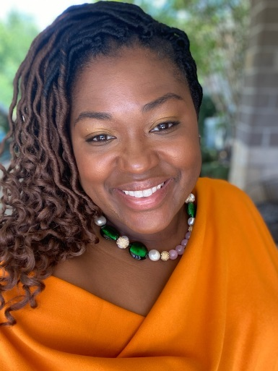
Who am I?
From Selma, Alabama
Graduated from Spelman College
Previous roles consisted of :
Change Management & Talent Organizational Manager
Human Resource and Employee Engagement Specialist across various Fortune 500 companies
Founder of
Black Belt Community Development Coalition
Prestige Consultancy
Member of
Alpha Kappa Alpha Sorority, Inc.
The Links Incorporated
Alabama Primary Care Association Board
Congressional District 07 COVID-19 Advisory Board
Wife and Mother of four children
“The Heartbeat of the Black Belt”

Slide 28
About us
Federally Qualified Health Center
Established in 1977
8 clinic locations, 1 mobile unit, 1 administration office
Serving the Black Belt Region across 5 counties in Alabama
60 + employees
Approximately 8,000 patients and counting
“The Heartbeat of the Black Belt”

Slide 29
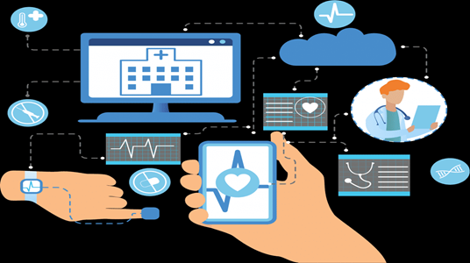
About US - Services Offered
Specialty Services
Dental
Vision
Podiatry
Behavioral and Mental Health Services
Currently conducting outreach for COVID-19 Testing
Primary and Preventative Healthcare
Telehealth
Pharmacy
Patient Assistance Program
Social Services
Case Management
Mobile Clinic
“The Heartbeat of the Black Belt”

Slide 30
About US
The RHMPI mission is to provide quality and preventative healthcare services while offering an exceptional customer experience at an affordable cost.
It is our goal to continuously improve the number of patients served each year by:
increasing awareness of the services we offer,
increasing patient access to our primary healthcare services, and
partnering with other community agencies to connect individuals across the communities we serve to tangible resources needed in their everyday lives.
“The Heartbeat of the Black Belt”

Slide 31
RHMPI and BWHI partnership
RHMPI joined the Black Women’s Health Imperative’s provider network in 2017 and began enrolling participants in 2018. Since that time we have received 101 health care provider referrals and enrolled 70 participants.
Challenges to referrals and enrollment include:
The need to increase awareness among health care providers regarding prediabetes and the importance of screening
The need for more education community-wide so that residents know the importance of focusing on prevention
Many residents just do not want to commit to a yearlong program
“The Heartbeat of the Black Belt”

Slide 32
RHMPI and BWHI partnership
Examples of how RHMPI is addressing those challenges:
On-going health care provider education
On-going community education and increased visibility of the program
Identification of health care provider champions
Assigned lifestyle coaches to be onsite at each of our health center locations
Recruitment of diverse lifestyle coaches who identify with the target population
Signed formal agreements with 4 local employers to provide primary health care services for their employees. RHMPI will introduce the program to those employees.
“The Heartbeat of the Black Belt”

Slide 33
But there were more challenges that were not as obvious

Slide 34
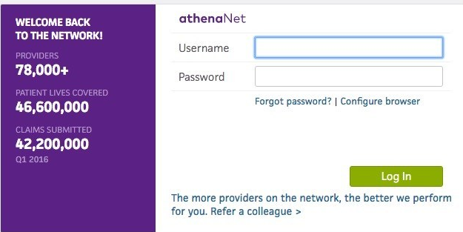
Internal Tracking TOOLs for sdoh
EHR System
Athena Health Net
Social Services Team
Licensed Social Worker
Licensed Counselor
Through additional interviewing
i2i Population Health
Future Implementation August 2020

Slide 35
Sample Test Patient chart – social history

Slide 36
Sample Test Patient chart – social history

Slide 37
Sample Test Patient chart – social history

Slide 38
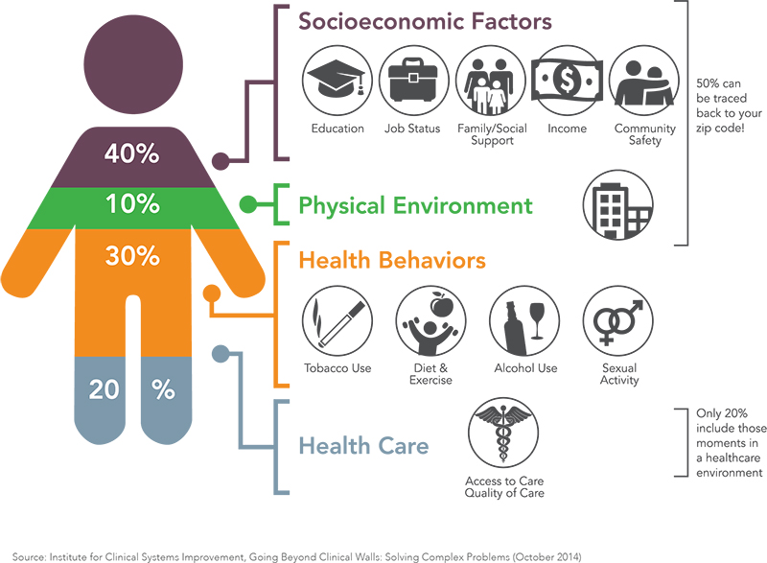
Major RHMPI SDOH’s
The major SDOH’s that interferes with participants from enrolling and maintaining participation after screenings and referrals are:
Affordability of Medical Services
Affordability of Pharmacy Cost
Cost of Transportation
Health Care Literacy
Access of healthcare facilities
Language Barriers
Child Care
Lack of Social Services
Behavioral Health
Lack of Health Food Access

Slide 39
population characteristics Income & Poverty

Slide 40
population characteristics Education

Slide 41
sdoh AROUND PREDIABETES
Across the Black Belt region of Alabama, the Rural Health Medical Program, consistently find the following reoccurring social determinants of health:
Access to healthy food choices (local groceries store/ farmers market/variety of restaurants)
Acceptance and self-accountability of health care educational literacy offered by RHMPI
Lack of healthy lifestyle initiatives within household and/or community
Lack of access to outdoor activities/walking trails
Affordability of gym memberships/fitness clubs

Slide 42
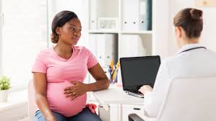
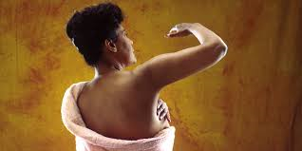
sdoh Program Implementation
RHMPI implemented the following programs to address social determinants and barriers:
Implementation of Diabetes Improvement Initiative-Type I (2018)
CYL² - Type II Diabetes prevention program (2018)
Providing education and resources
Classes within their communities
Provide Transportation
Chronic Care Program – pre-existing health care conditions in patients 55 and up (2018)
Social Services Referrals
Utility Financial Assistance
Food Assistance Program, and
Transportation Assistance Program and Local Partnerships(2019)
RHMPI Shuttle (Temporarily on hold due to pandemic)
“The Heartbeat of the Black Belt”

Slide 43
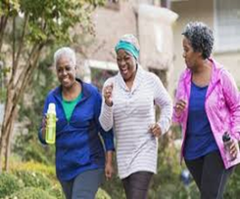
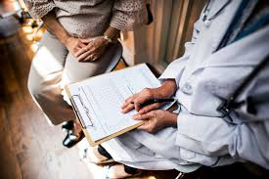
sdoh Program Implementation
RHMPI implemented the following programs to address social determinants and barriers:
Alabama Breast & Cervical Cancer Early Protection Program (ABCCEP) – targeting women 35 and up, low to no income to gaining access to women’s health screening and health services as needed (2016)
340B Program (2018) allows us to provide
Medication,
Medical supplies,
Medical equipment, and
Financial assistance
“The Heartbeat of the Black Belt”

Slide 44
Questions
Contact us for more information.
101 Park Place Selma, Alabama, 36701
www.rhmpi.com
334.874.7428
“The Heartbeat of the Black Belt”
Dallas. Marengo. Monroe. Perry. Wilcox.

Slide 45
“The Heartbeat of the Black Belt”
Dallas. Marengo. Monroe. Perry. Wilcox.

Slide 46
Q an A
If you have any questions, please type them in the Q/A box and we will address them during the Q/A session.

Slide 47
Additional Resources:
ACPM: https://www.acpm.org/initiatives/diabetes-prevention/
BWHI: https://bwhi.org/change-your-lifestyle-cyl2/
AMA: https://amapreventdiabetes.org/

